Slide 1
Dynamo
Lecturer: Ngo Huy Bien
Software Engineering Department
Faculty of Information Technology
VNUHCM - University of Science
Ho Chi Minh City, Vietnam
nhbien@fit.hcmus.edu.vn

Slide 2

Objectives

Slide 3

Contents

Slide 4

References
Giuseppe DeCandia et al. (2007). Dynamo - Amazon's Highly Available Key-Value Store.

Slide 5
Dynamo [1]
Dynamo stores objects associated with a key through a simple interface; it exposes two operations: get() and put().
Dynamo's partitioning scheme relies on consistent hashing to distribute the load across multiple storage hosts.
To achieve high availability and durability, Dynamo replicates its data on multiple hosts. To maintain consistency among its replicas, Dynamo uses a consistency protocol similar to those used in quorum systems.
Dynamo provides eventual consistency, which allows for updates to be propagated to all replicas asynchronously.
Dynamo uses vector clocks in order to capture causality between different versions of the same object.

Slide 6
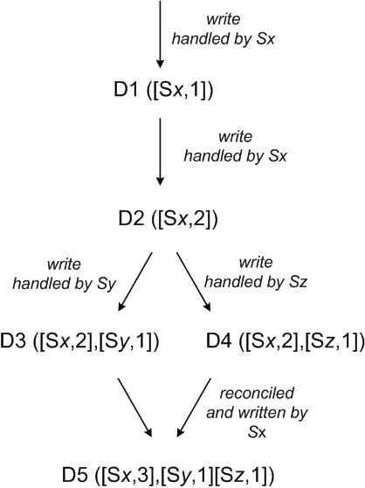
Version Evolution of an Object
There are changes in D3 and D4 that are not reflected in each other.
Both versions of the data must be kept and presented to a client (upon a read) for semantic reconciliation.
If the client performs the reconciliation and node Sx coordinates the write, Sx will update its sequence number in the clock.

Slide 7


Slide 8

Thank You & See You Again

